Slide 1


Slide 2

Group 6
Web Scraping Project
COVID-19
Response from HK
Ki Yeung
Richard Ng
Jacky Chan
Kurtis Chan 14 Sep 2020

Slide 3


Project Aim
Study the issue of covid-19 in Hong Kong
Using the power of data and analytics
Identify the ways of defending the infection of covid-19
Through the individual actions and in our government measures.
Prevention of the future pandemics

Slide 4


Business Value
Raise the individual awareness of public health
Set a standard guidance of measures for our government to adapt.
Prevent the loss of lives and economic impact from the future pandemics.

Slide 5
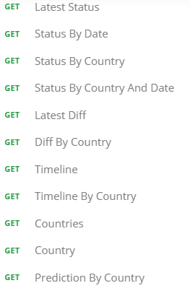
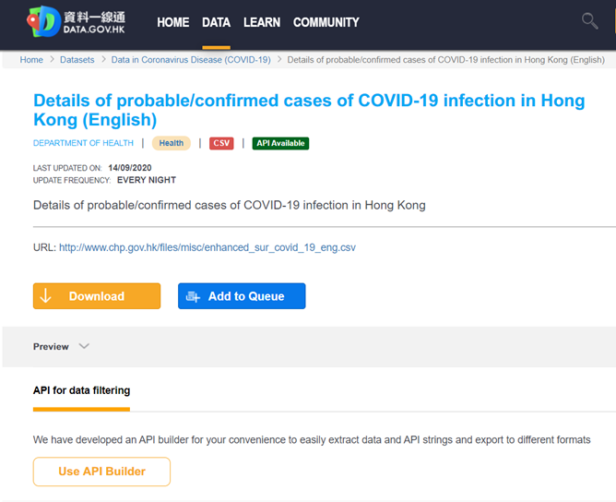

Data Collection and Preprocessing

Slide 6
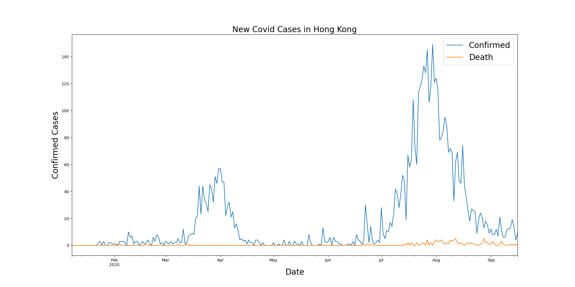

Slide 7
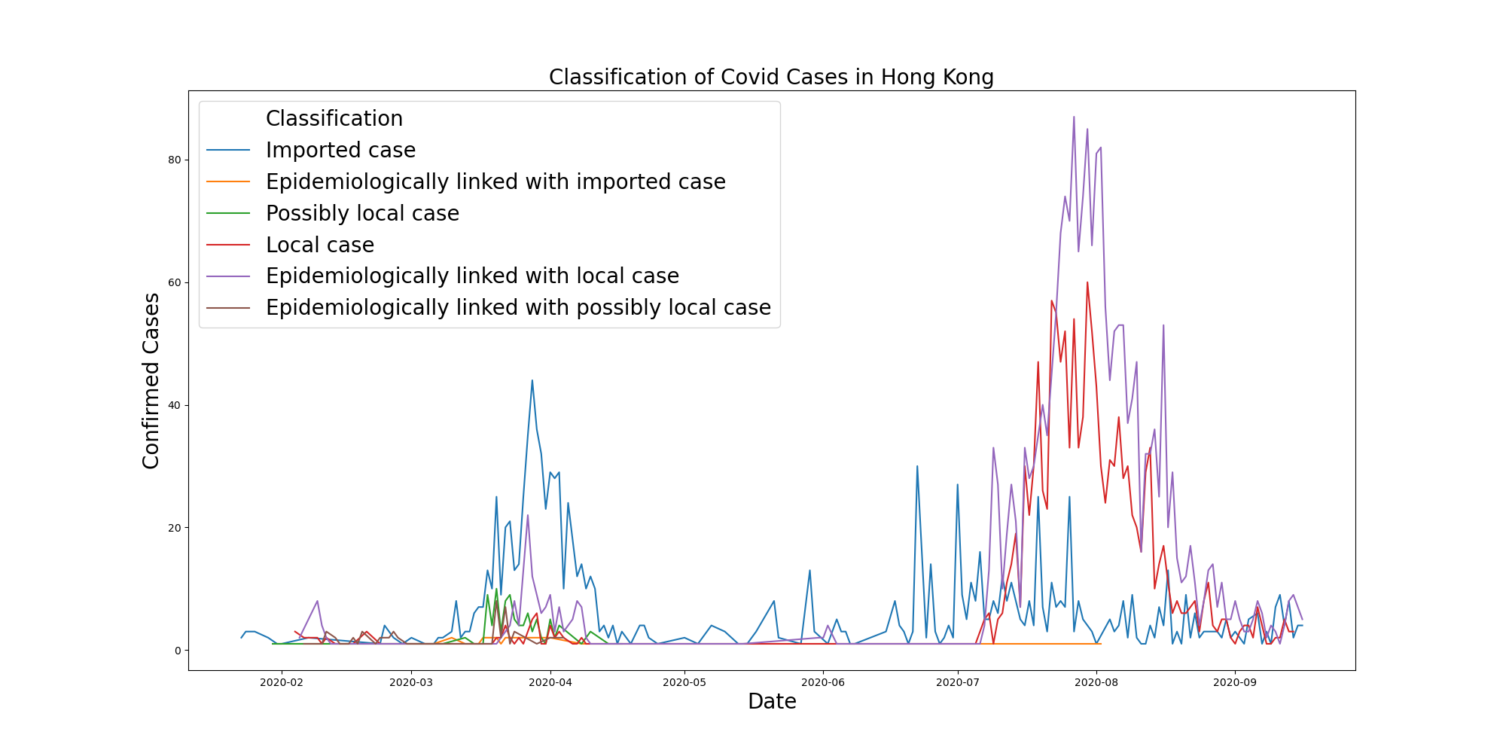

Slide 8
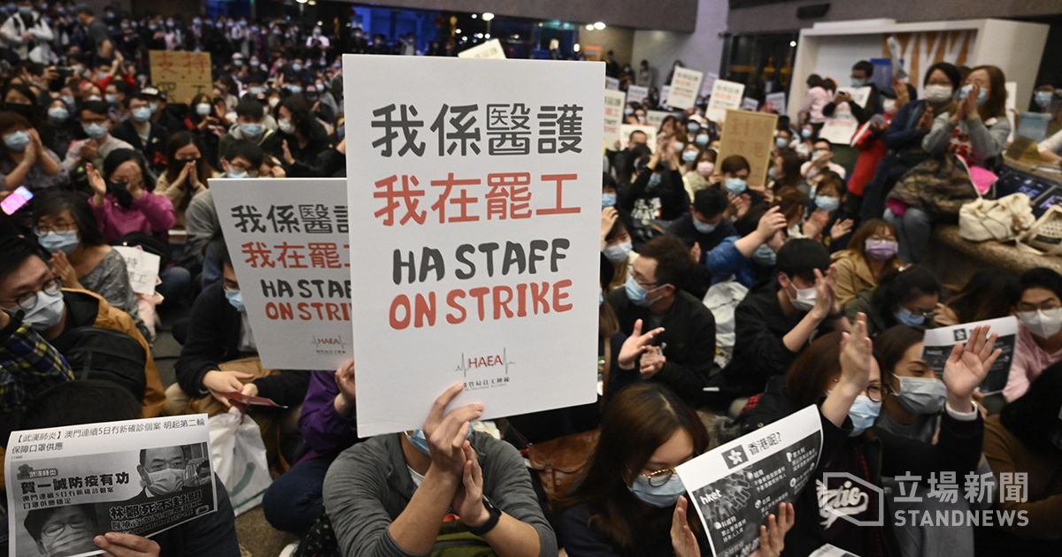

Slide 9

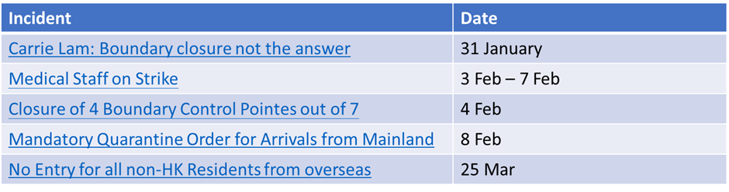
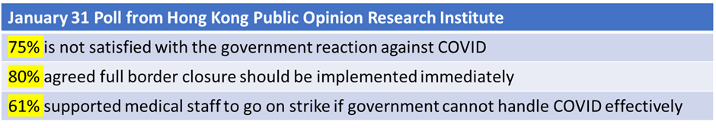


Brief Overview of Border Control Timeline

Slide 10


Individual Awareness

Slide 11
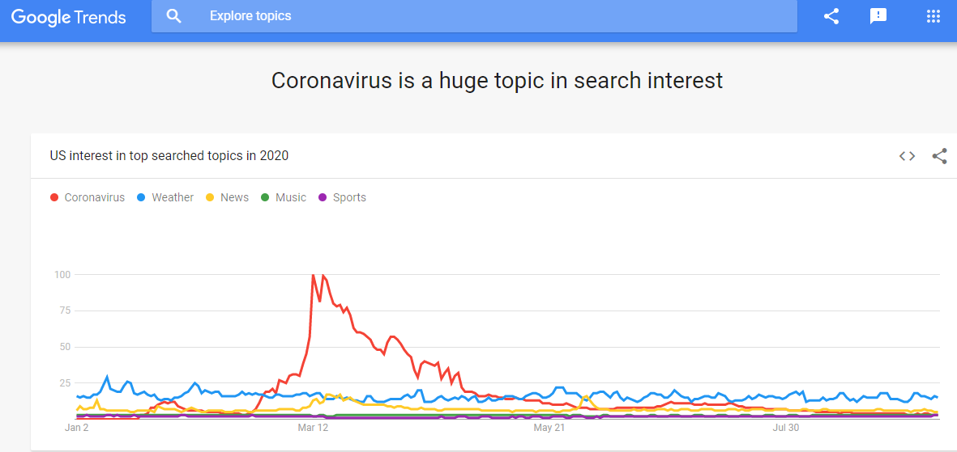
Google Trends

Slide 12
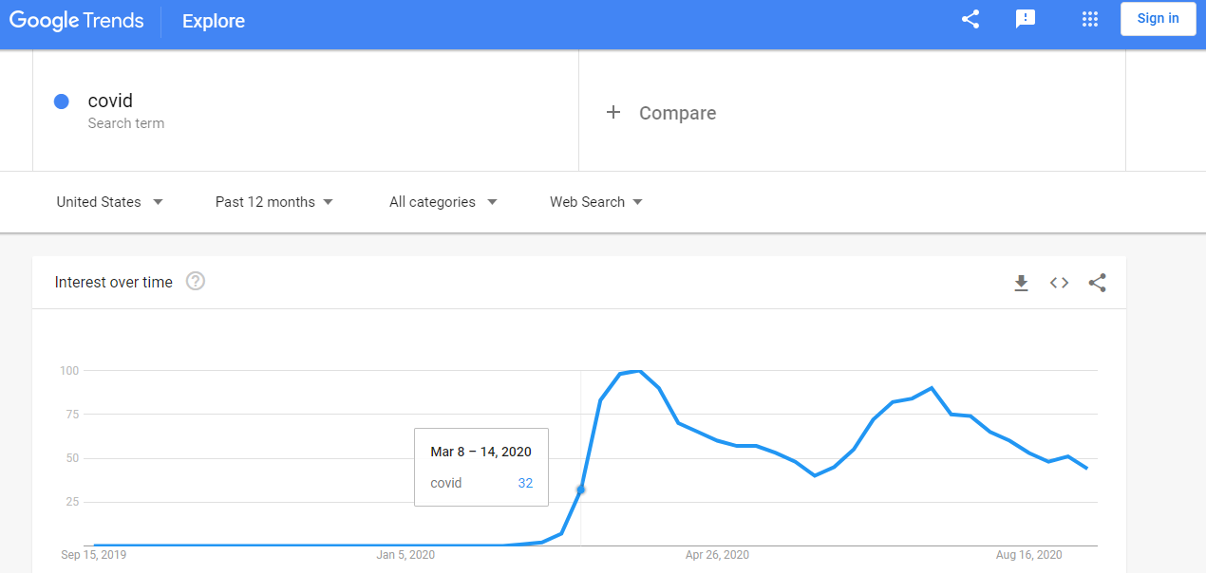

Slide 13
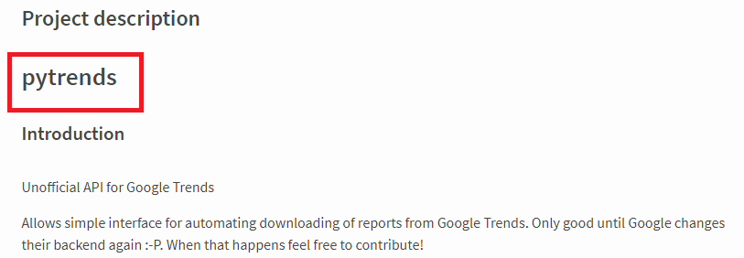
Google Trend unofficial API - pytrends

Slide 14
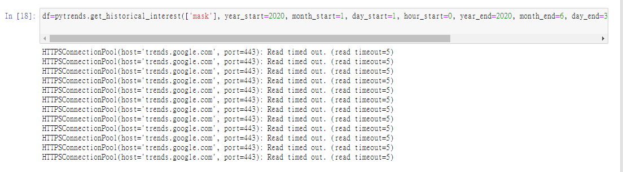
Pytrends

Slide 15
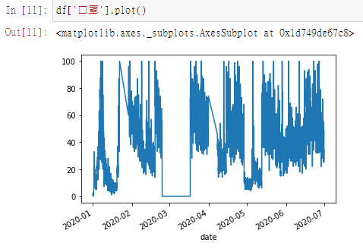
Pytrends

Slide 16
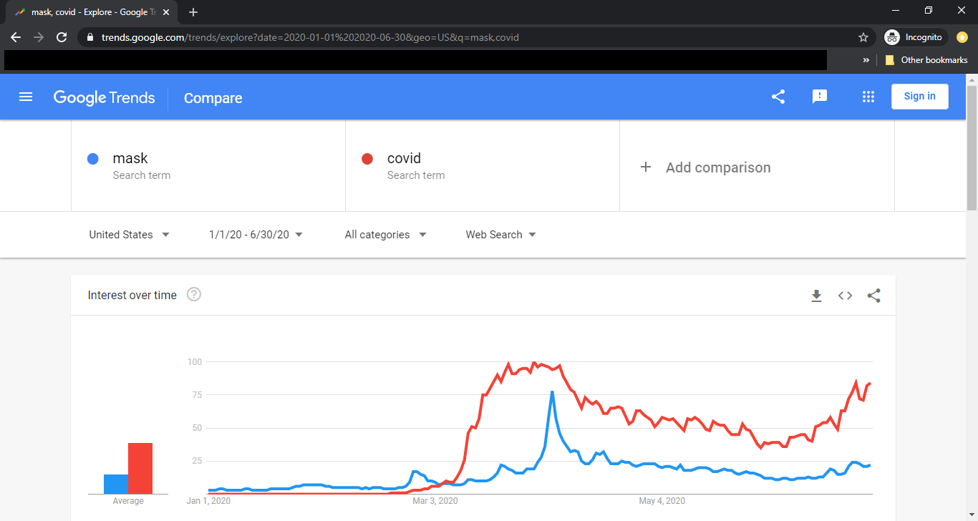
getdatacsv

Slide 17
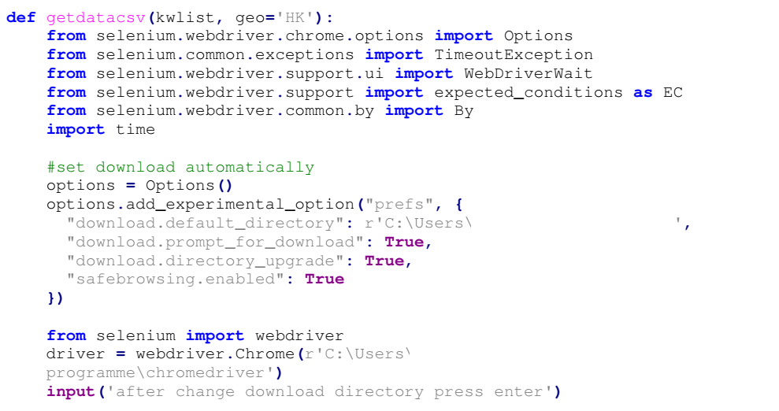
getdatacsv

Slide 18
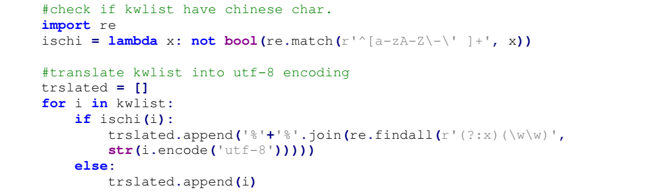
getdatacsv

Slide 19
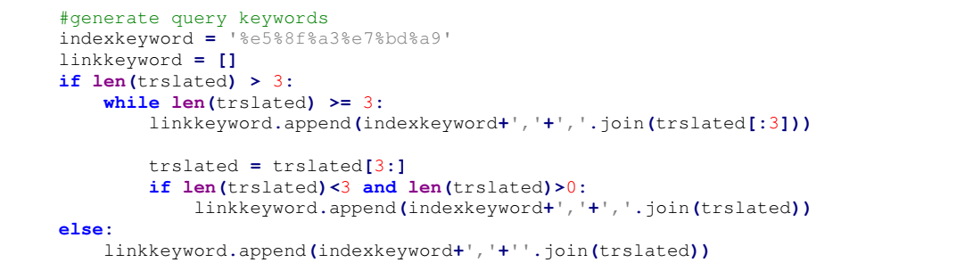
getdatacsv

Slide 20
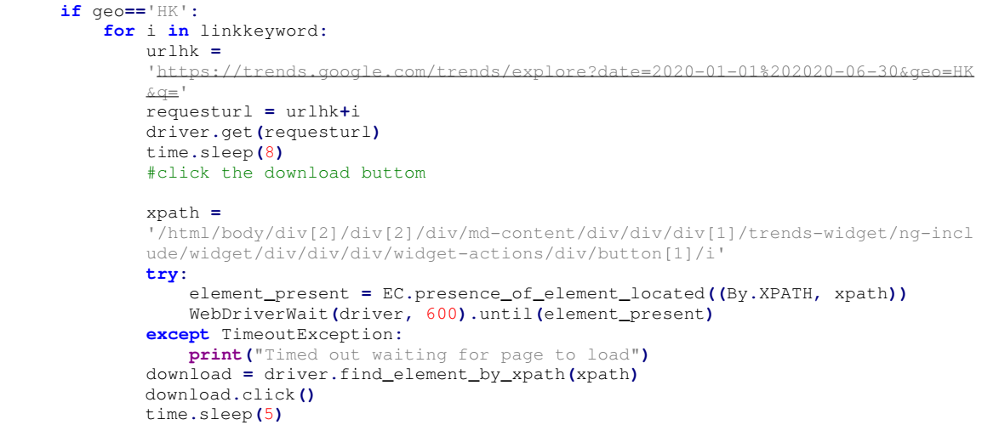
getdatacsv

Slide 21
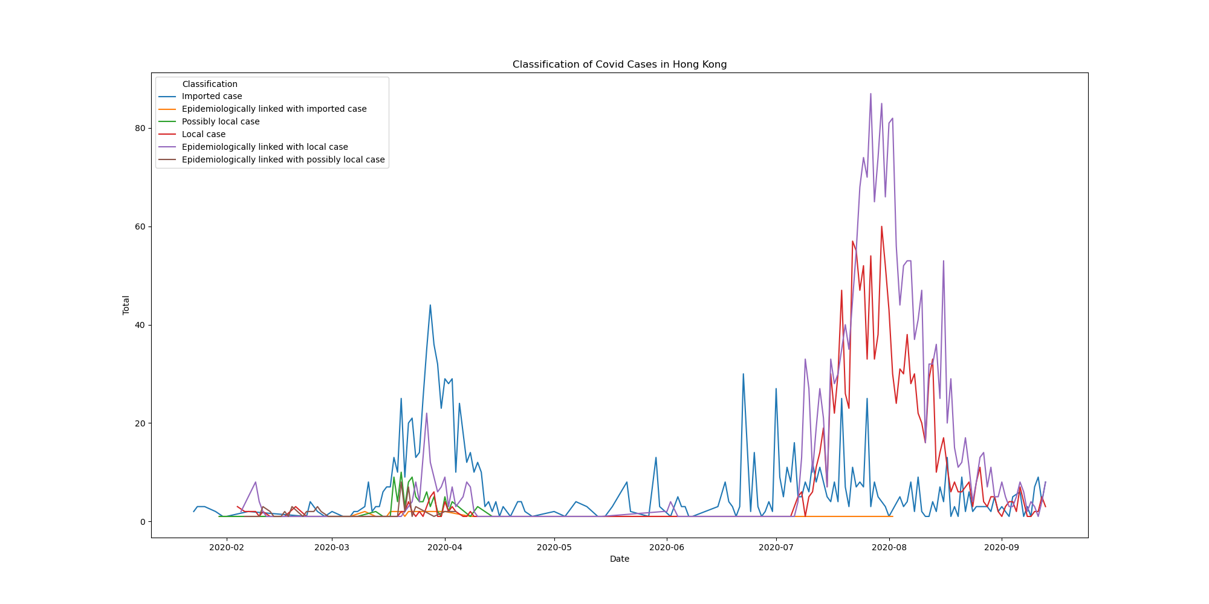

Slide 22
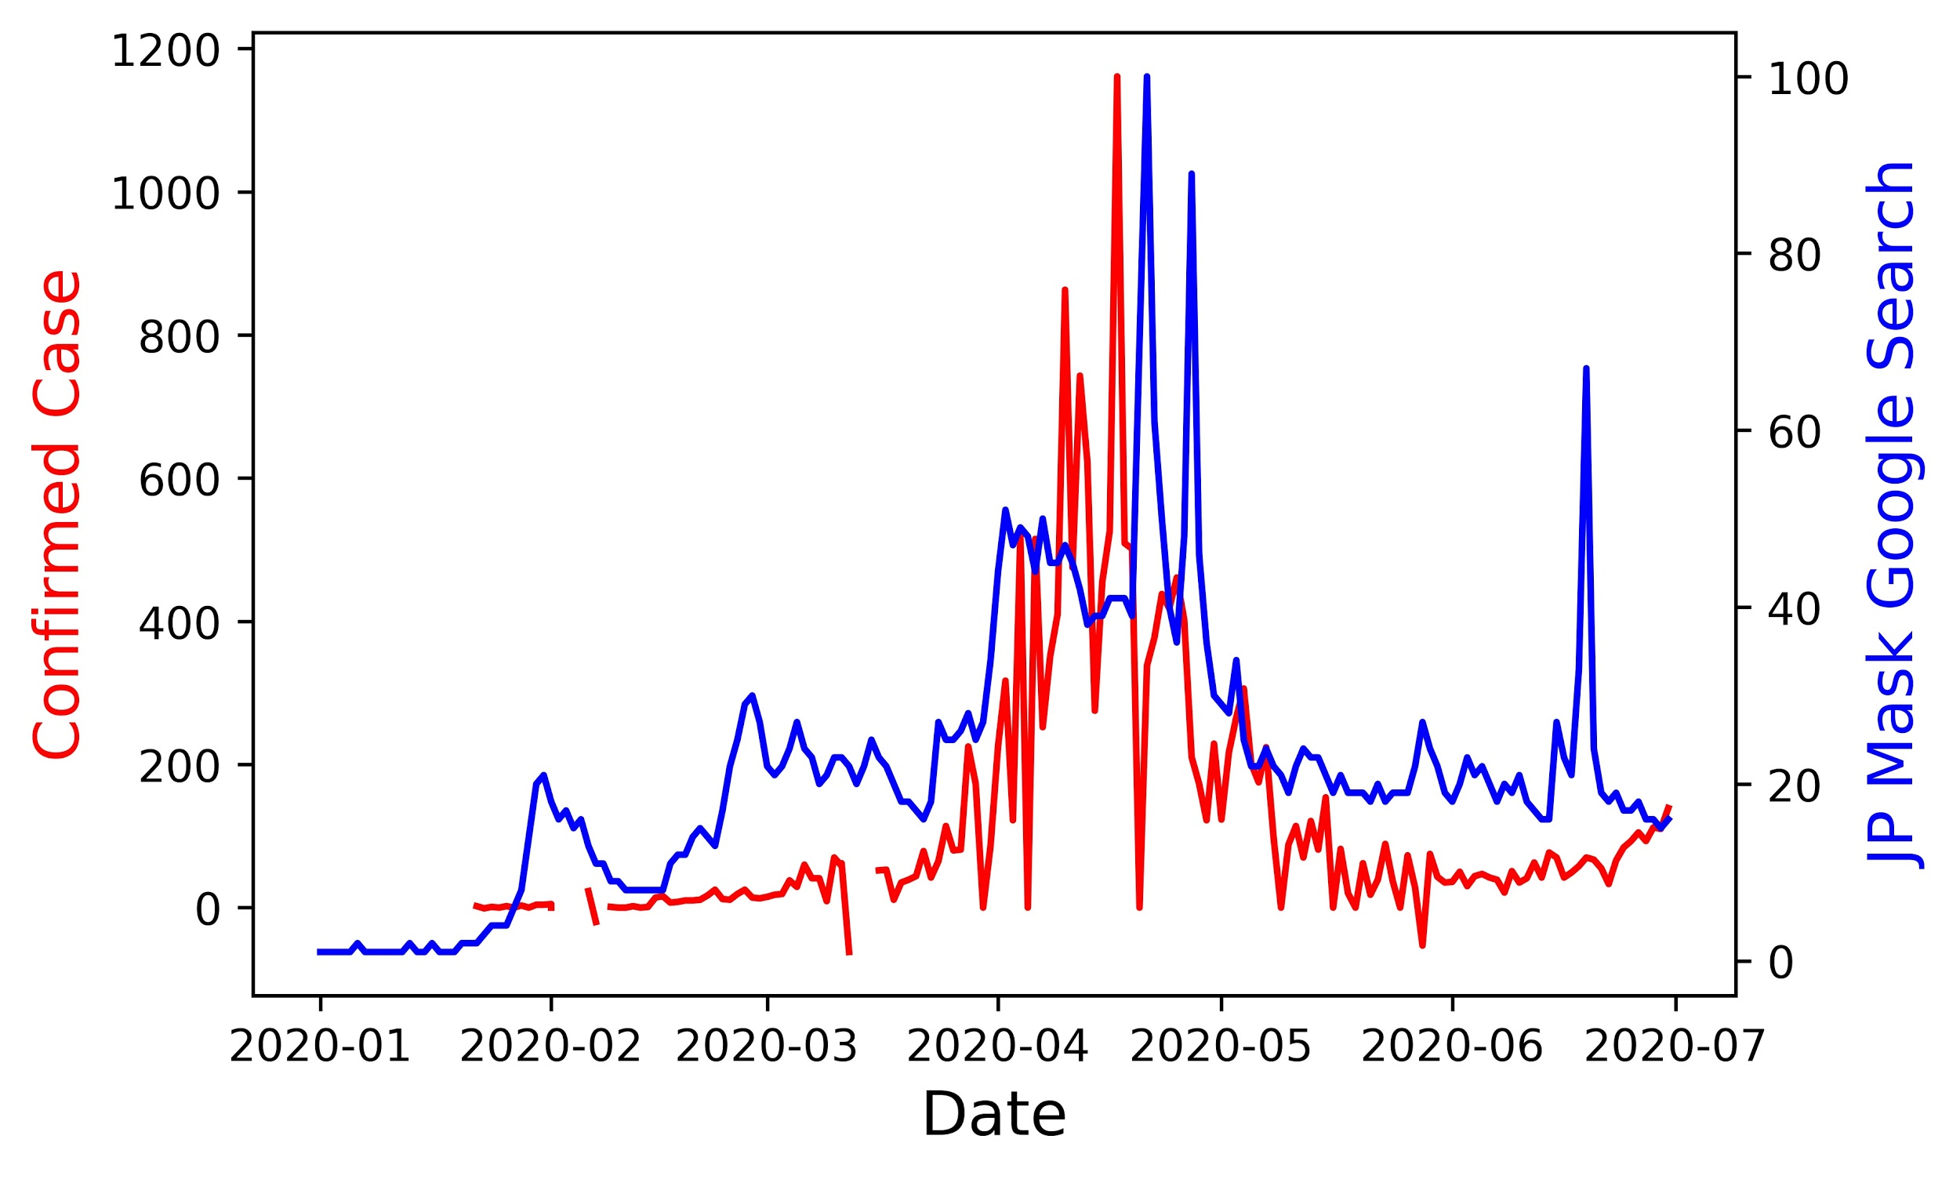
Japan

Slide 23
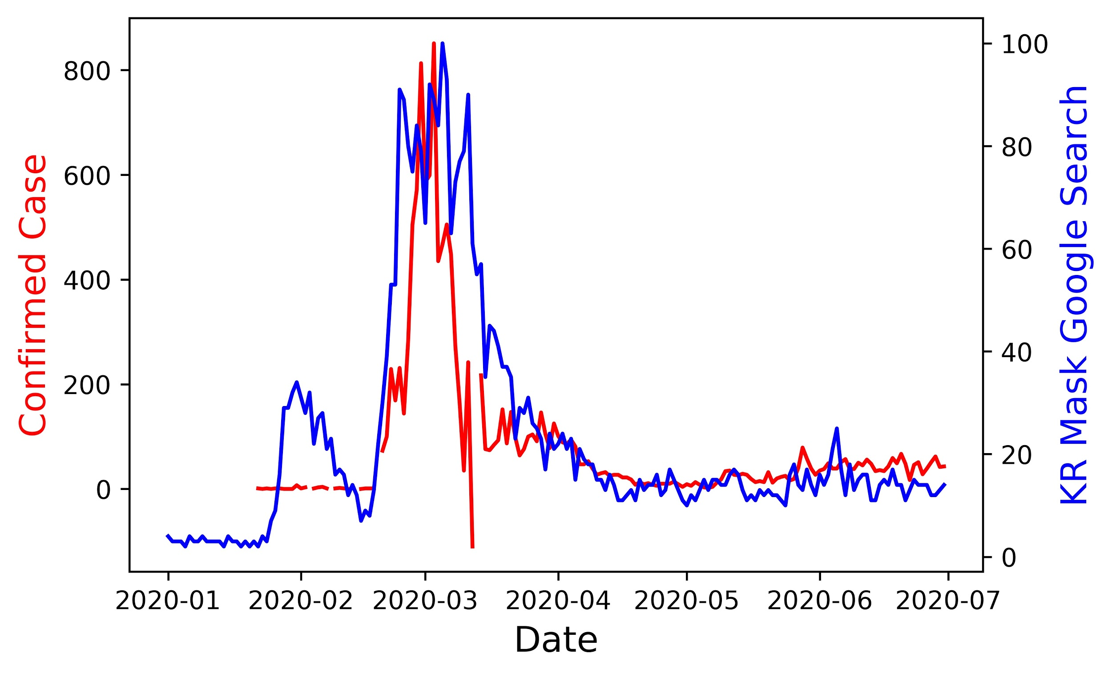
Korea

Slide 24
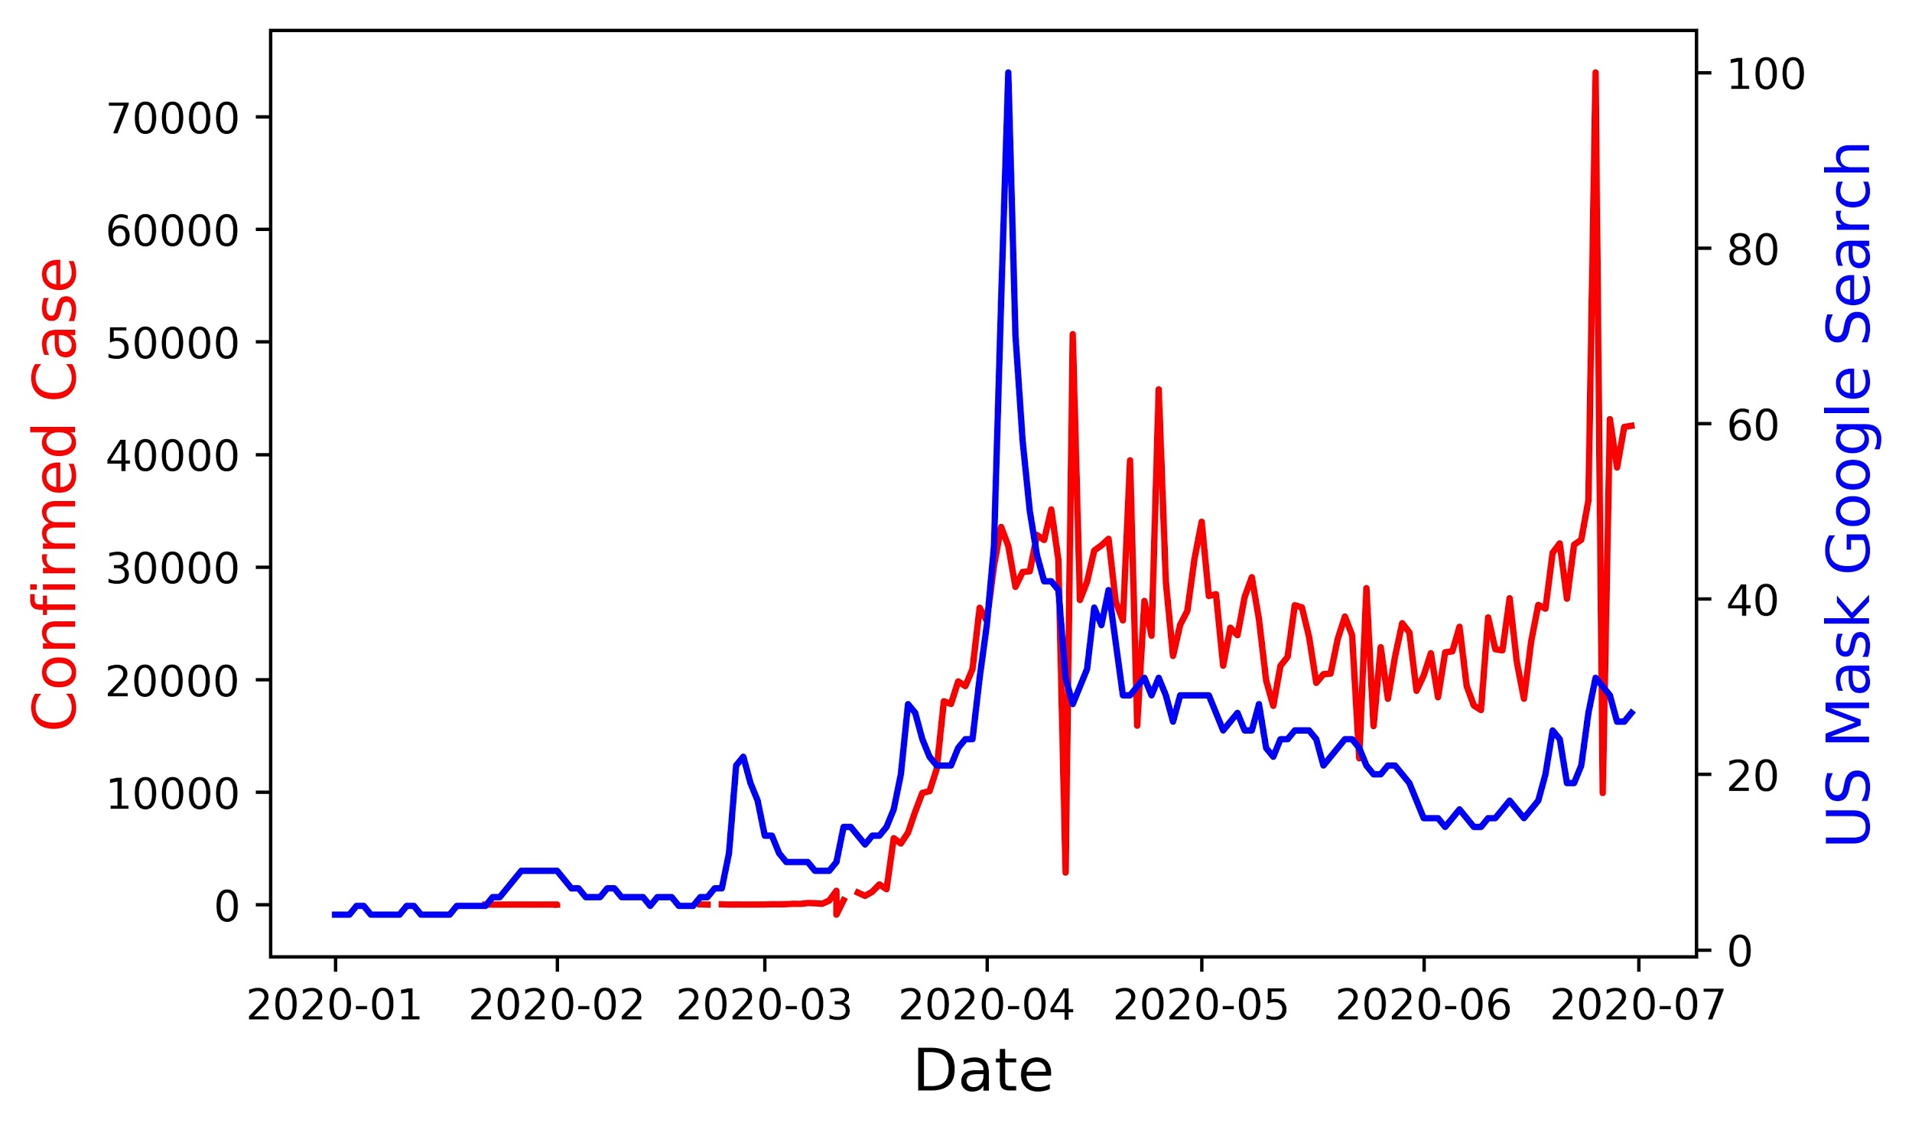
USA

Slide 25
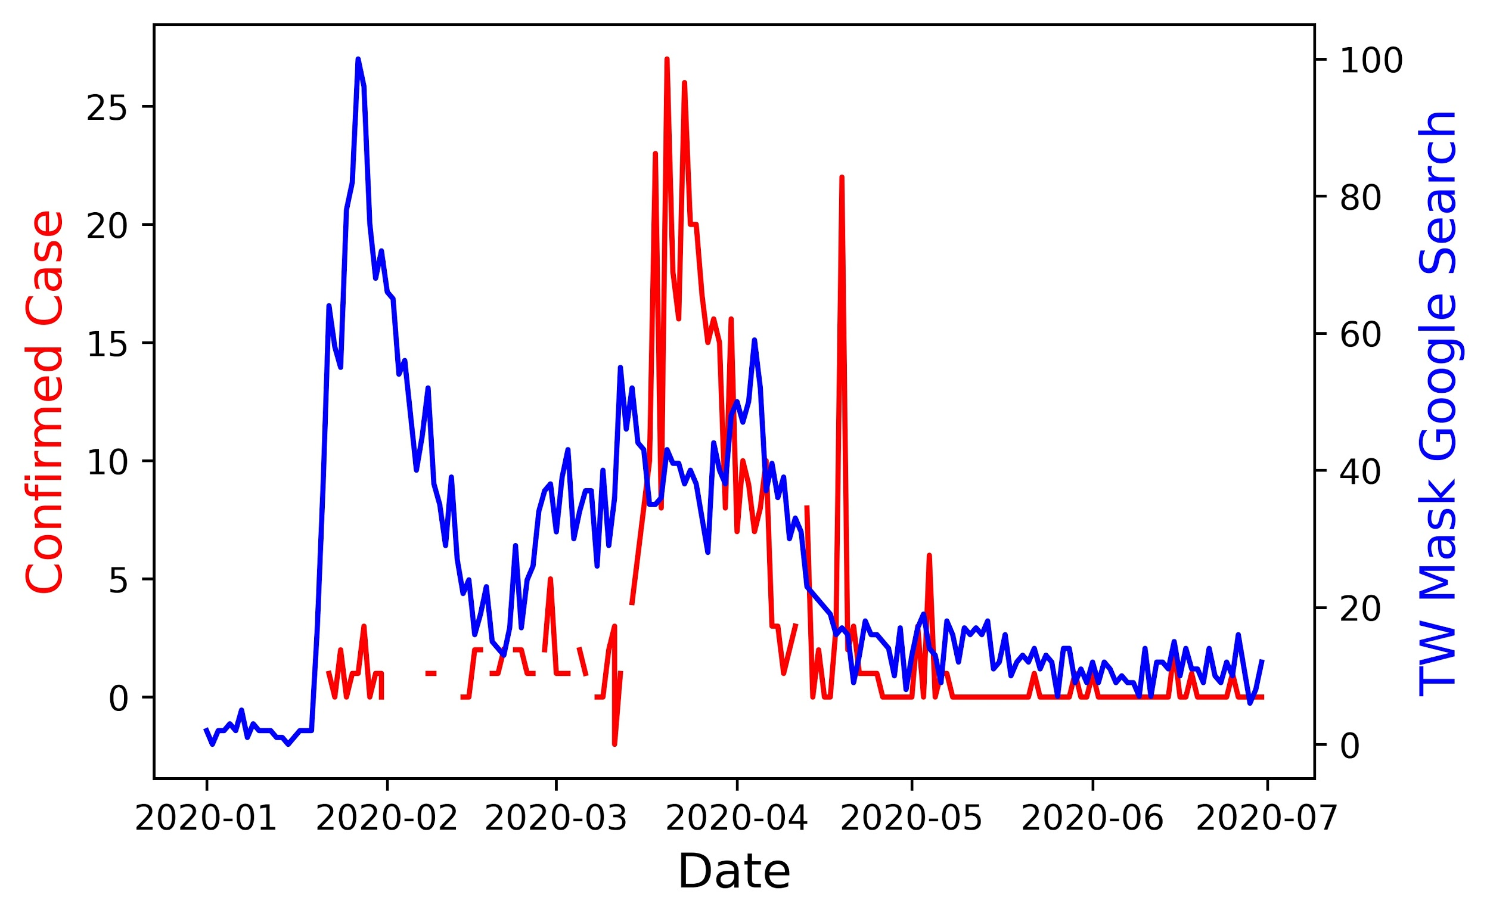
Taiwan

Slide 26
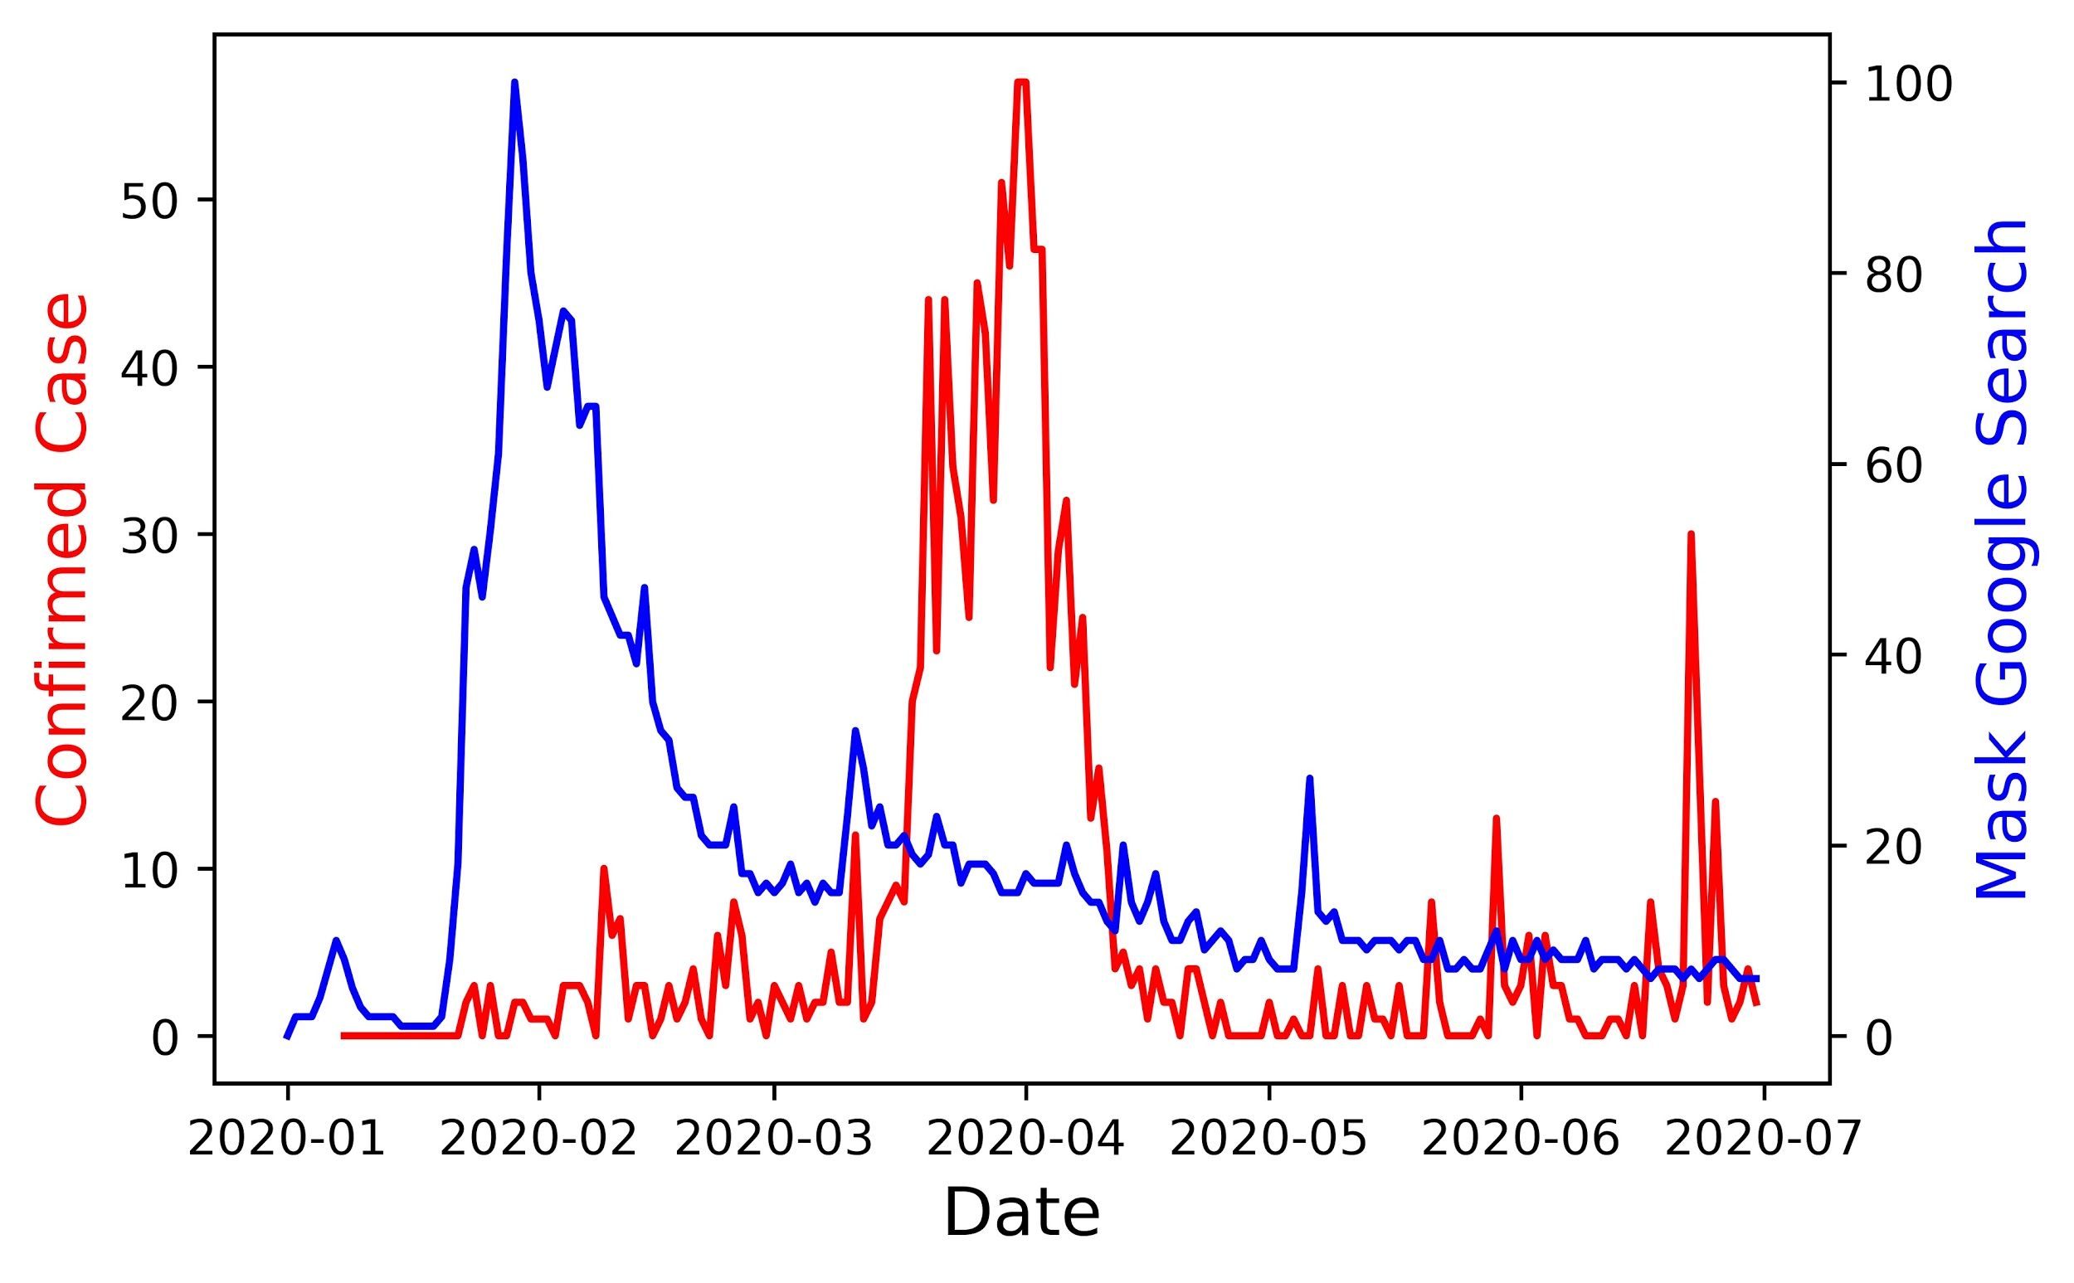
HK

Slide 27
Korea
HK
Japan
Taiwan
USA

Slide 28


Sources of Government Data
Websites of Government Press Release
www.news.gov.hk
www.coronavirus.gov.hk
Data Scripting
Web scripting and Python Library “Camelot” (extract tabled text data from PDF files.)
Data Cleaning
Remove commas and symbols, then
Append all files into a dataframe.

Slide 29
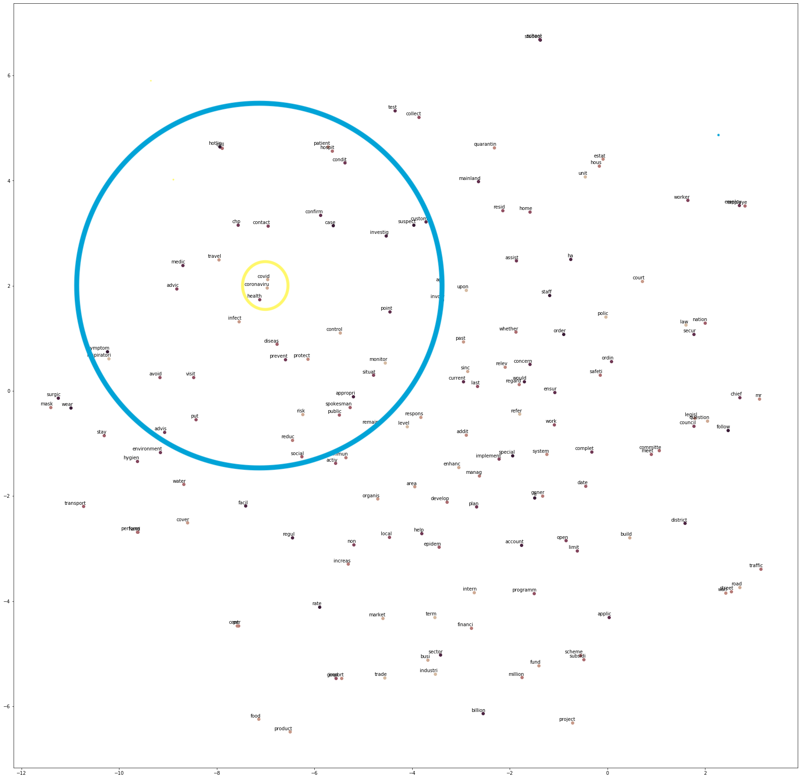
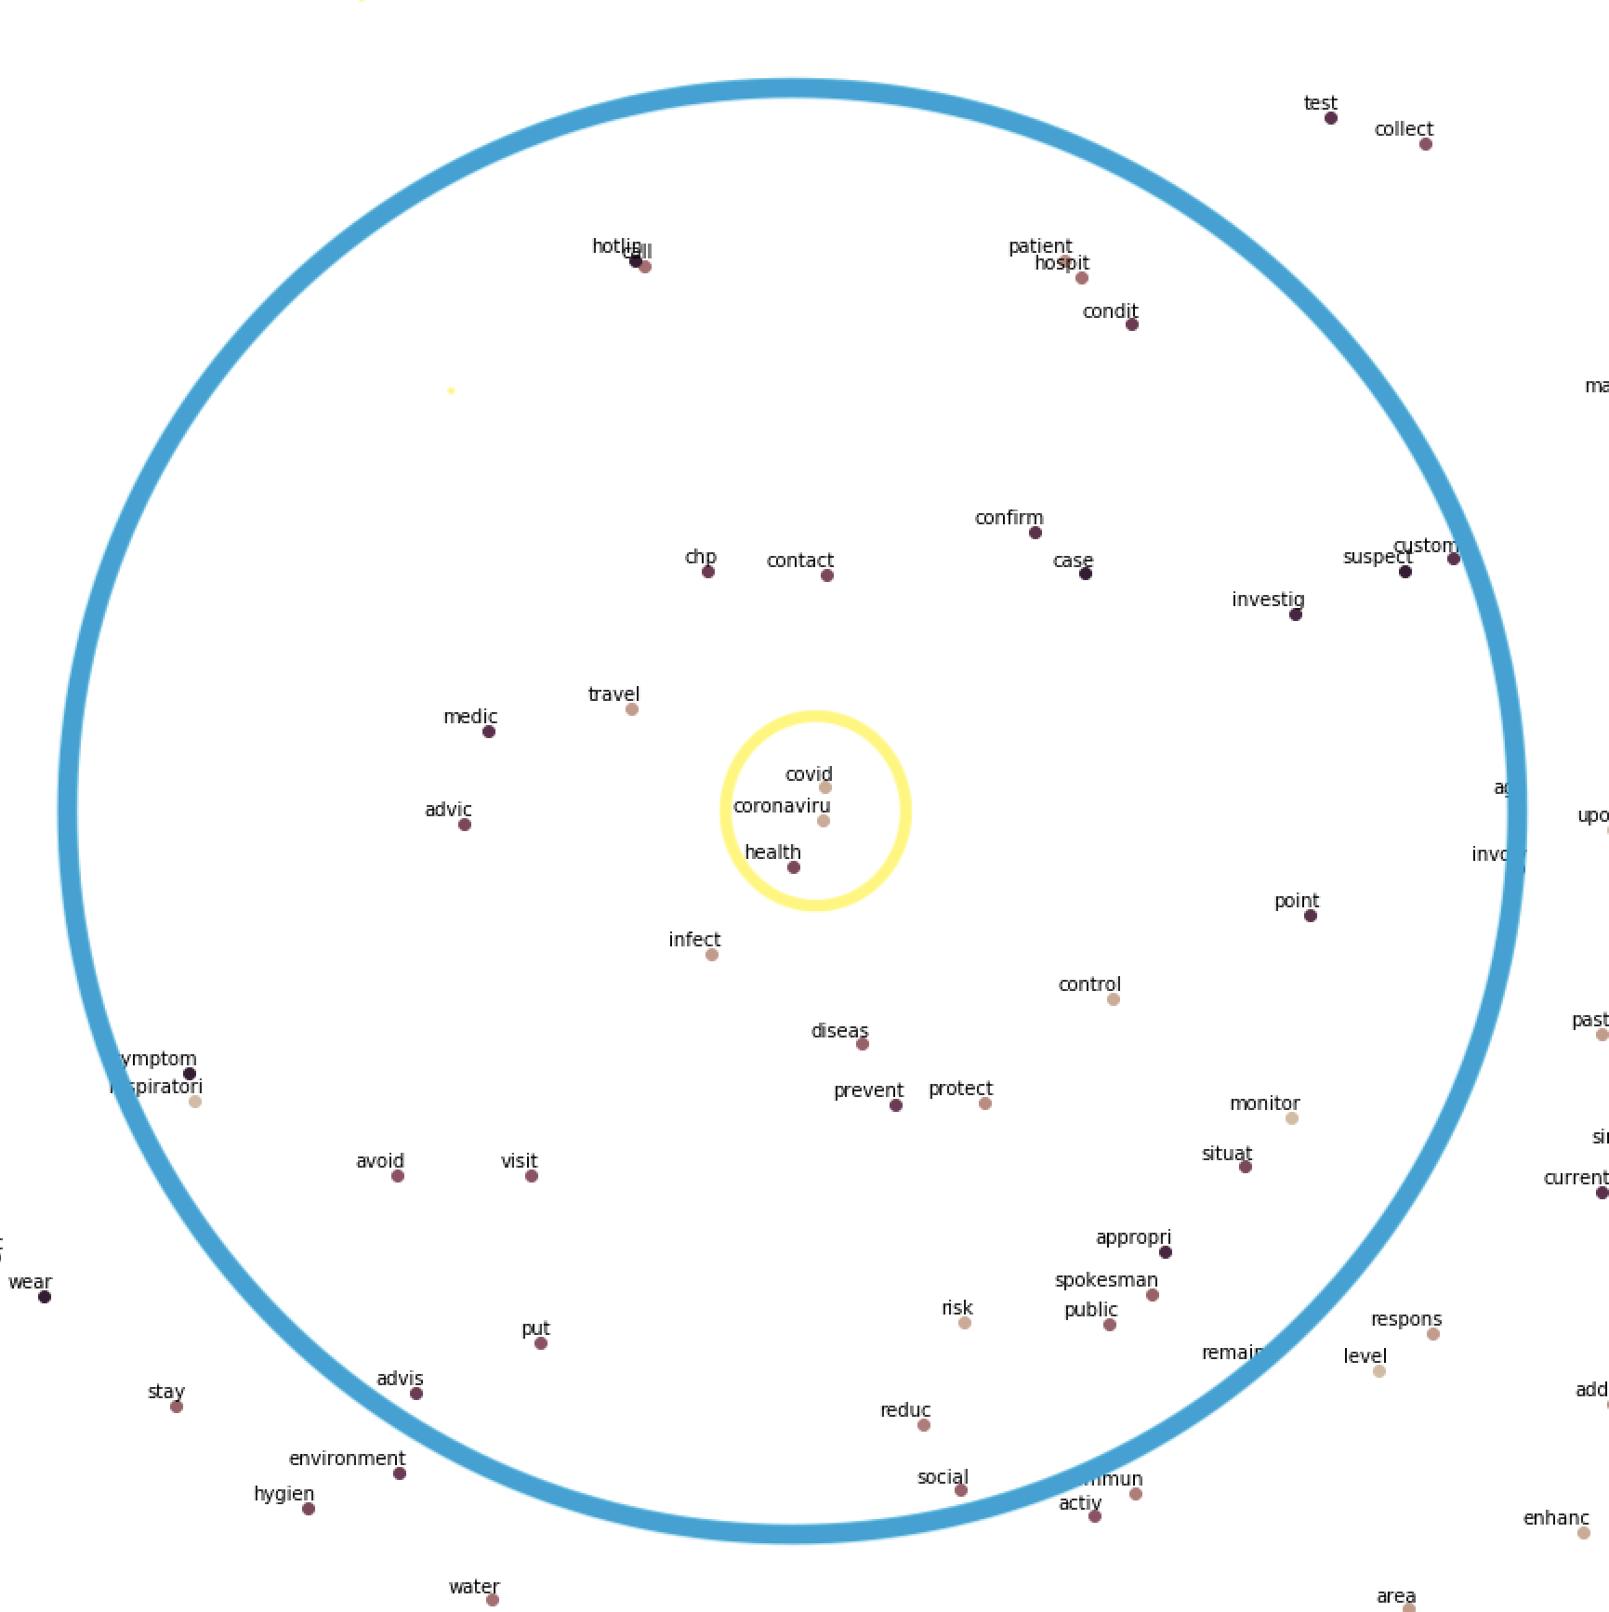
Plot of Words With Frequency More Than 1000 times
For words closer to each others, the more related they are
For the pink boxes close to the yellow circle, it means the words inside are more related to coronavirus
Finding:
prevent disease with protection
reduce social activities
investigate suspected cases in custom
reduce travel and contact
avoid visit
Data plot for words in news.gov.hk
Prepared by Ki Yeung
Interpret by Kurtis Chan

Slide 30
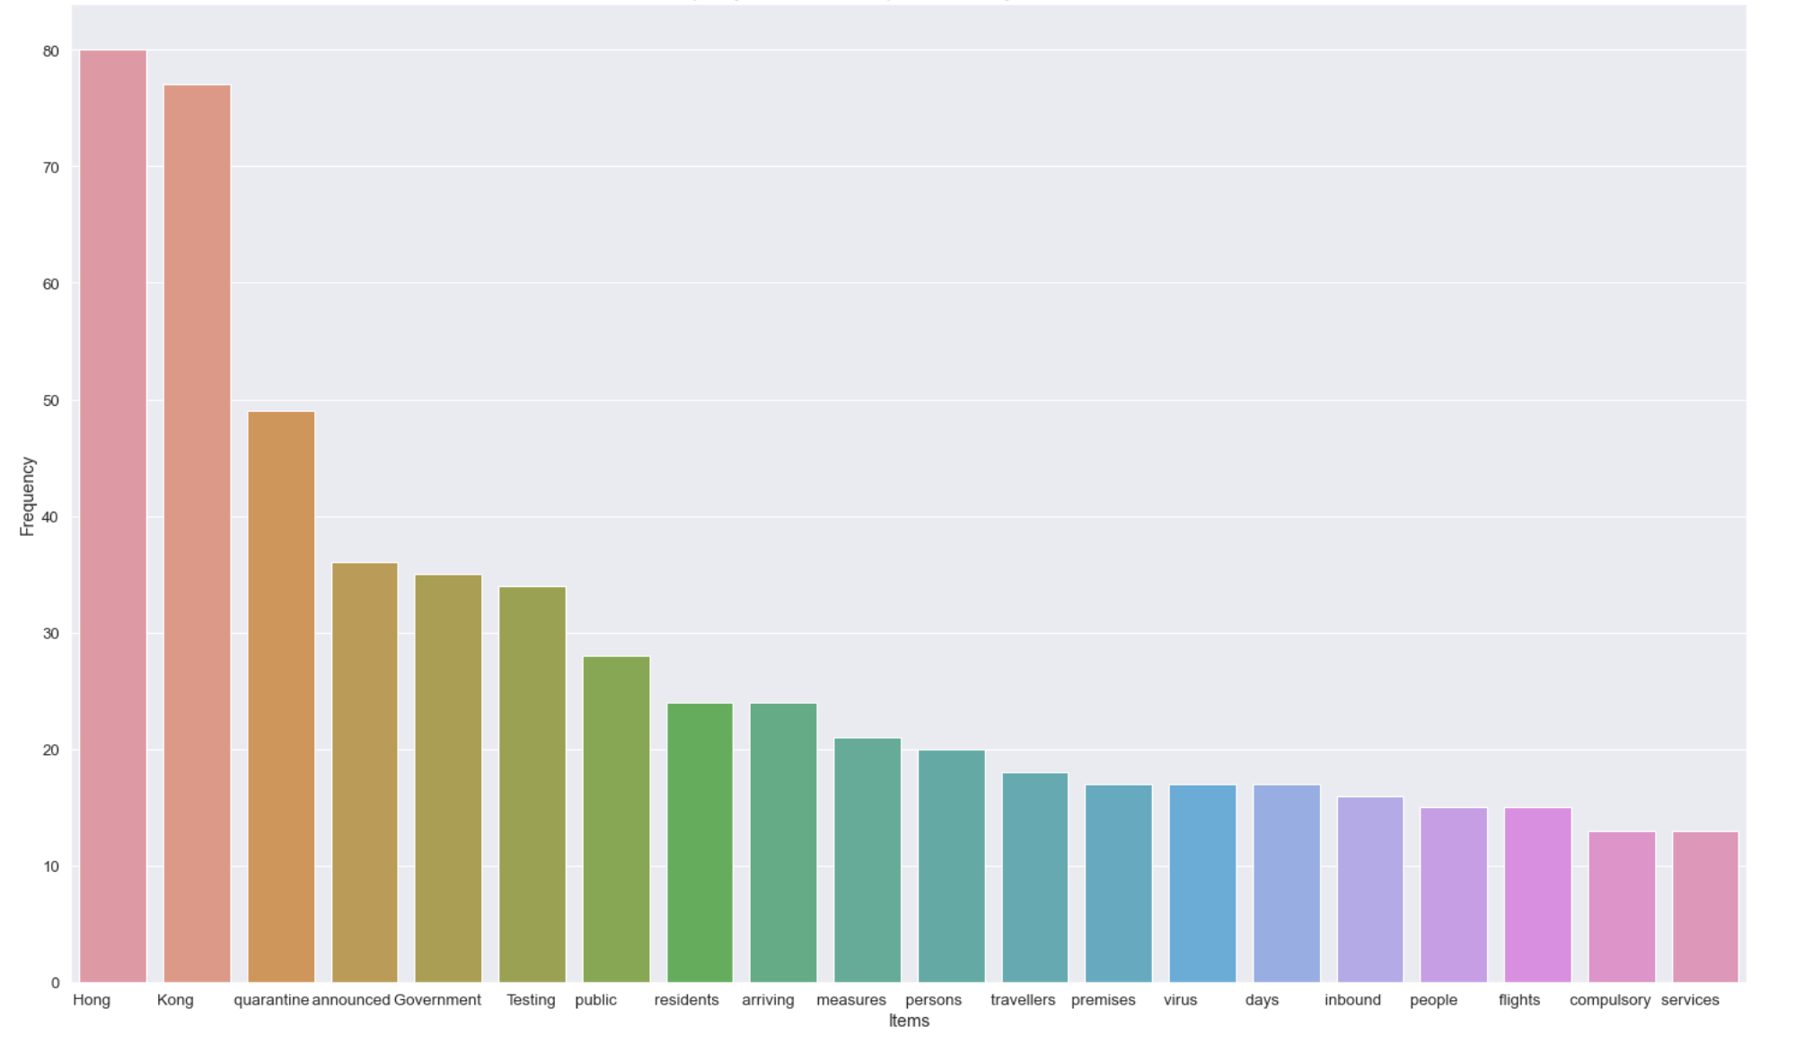
Top 20 keywords from the press release by CEO - Carrie Lam
Remarks:
4 most mentioned words by CEO in related to the government measures
quarantine
testing
arriving
travellers

Slide 31
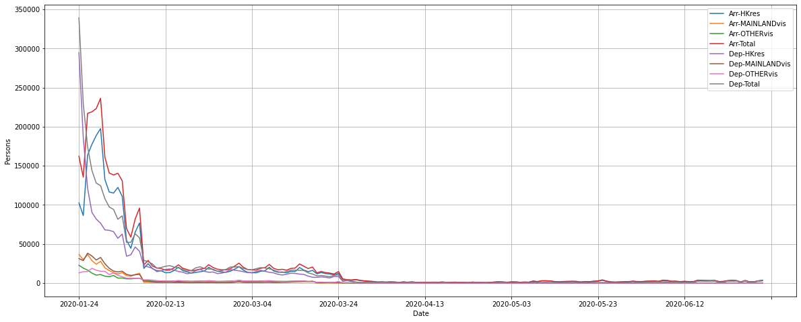
Immigration Statistics of Hong Kong (1st half of 2020)
FEB 08
MAR 19

Slide 32
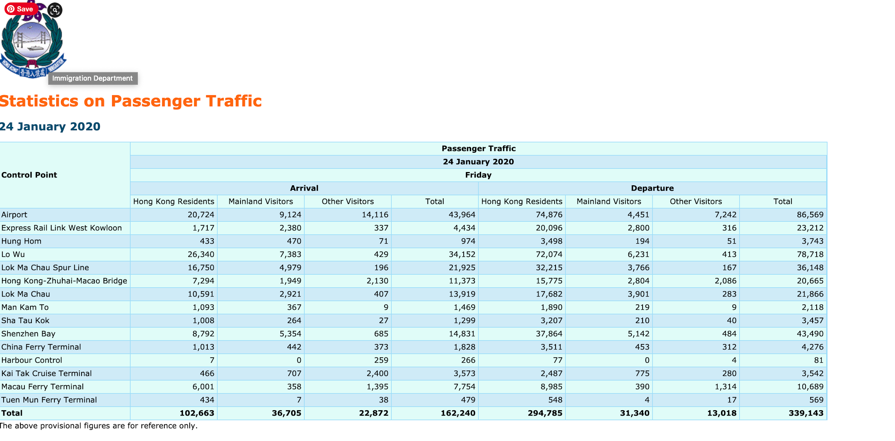

Slide 33
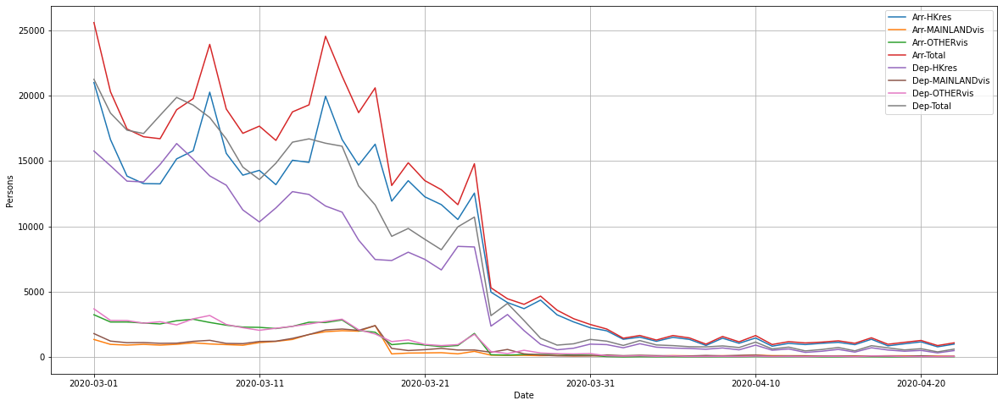
MAR 19

Slide 34
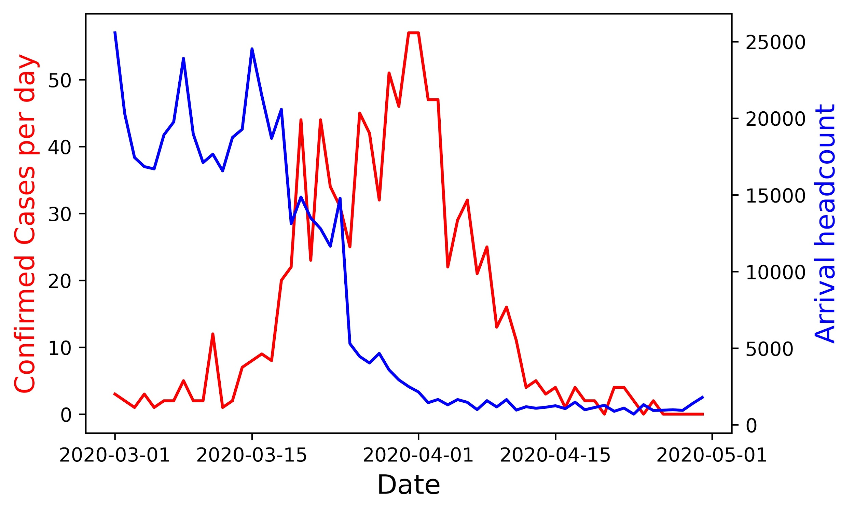

Slide 35

Conclusion
The general public and government in Hong Kong reacted to the rising numbers of the first COVID wave quickly enough to minimize the potential exponential increase of infected cases.
 | Hong Kong | Japan | Korea | Taiwan
First Infected Peak | 31 March | 18 April | 3 March | 20 March
Border Closure | -13 days | -33 days | +40 days | -1 day
Mask Search Peak | -61 days | +4 days | +2 days | -50 days
Infected % (as of 31 June) | 0.016% | 0.015% | 0.025% | 0.0019%

Slide 36
Challenges and Next Steps
Only number of confirmed cases are used as the parameters to evaluate the effectiveness of the measures by government and individual, and the time frame is confined to the first 6 months
Relative economic impact, virus lethality, long-term herd immunity, percentage of asymptomatic patients, performance of other countries can all attributed to the success of a society to cope with the virus
The project is very scalable though. Based on our current framework, we can expand the scope to longer timeframe and take the aforementioned parameters into account, hence producing a more holistic evaluation

Slide 37
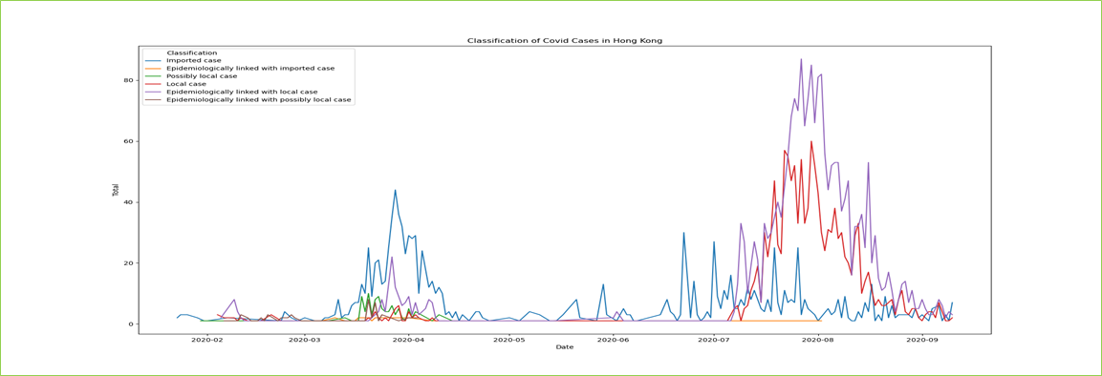


Q & A

